Slide 1
Painting 1 Showcase
2020

Slide 2
Michael Sebastian

Slide 3
Michael Lee Sebastian
Artist Statement
I received my Associates in Science in 2020 from Amarillo College. My current plan is to attend the University of Colorado in Denver pursuing a BFA in 3D Art and Animation.
From a very young age, my mind has shown a proclivity for music and arts. Nearly obsessive with a drum kit and passionate about my comic book collection, my path has always been forged in the arts. While cartooning and comic art are my passion, they have also helped lay a foundation for exploration and appreciation of more traditional artwork in my life.
My style at this point can not be pinned down to any particular medium; nor any particular style. Although my favorite work tends to deal with more flat renderings
Continued…

Slide 4
early in my explorations I practiced rigorously in an attempt to master three-dimensional works, as this is what got me the attention most artists crave, however I quickly grew tired of drawing people and objects how they appear in reality. On my 15th birthday I received a book detailing the life, work, and journals of Paul Klee, and my eyes were opened. Since this point in time, 16 years ago at the moment, I have explored music in connection to visual arts. I have attempted abstracts and surrealism, explored mediums such as oil paints, pastels, Copic markers, digital art, and polymer clay.
Going forward, especially entering university and forging my career in animation, I expect my work to migrate to a digital space. I will never give up physical mediums,
Continued…

Slide 5
the nostalgia and presence of the physical will always be powerful and unbending. My pursuits will involve bringing characters to life, working out storyboards, conceptualizing new characters and, hopefully with practice and skill, one day bringing my own characters to life though media or some other digital medium.
In summation, professionally I strive to create meaningful content that people enjoy. Privately, I strive to create works that evoke emotion; whether that be through a socio-political lens, a mind-expanding entheogenic lens, or simply a synesthetic experience through one’s visual cortex.

Slide 6
The Dress Dummy by Michael Lee Sebastian

Slide 7
The Dress Dummy by Michael Lee Sebastian
Inspired by a broken and tattered dress dummy, this piece took on a life of its own. Originally composed as a quick gestural study, I abstracted the form into a continuous line drawing and cropped it, which is what you see in black paint on the canvas. From there I had partitioned areas, for which I ultimately decided on the color scheme and repetition of colors. I was deeply influenced by the artwork and journals of Paul Klee.

Slide 8
Gothic Revival at Sunset by Michael Lee Sebastian

Slide 9
Gothic Revival at Sunset by Michael Lee Sebastian
Originally in search of railroad tracks to photograph, I was disappointed with what I found. As I was heading home, I looked out of the car window and the sunset struck me. When I investigated further, the lights on the Santa Fe building flickered on This was my moment; this was my photograph; this was my painting. I began this piece with naivety and great optimism, yet as I painted the sky, I grew over-confident. This led me to be sloppy when painting the building itself, however it also helped me realize, with my disability, that it was ok to paint and position myself differently than other painters. Then, as I finished up the building and began working on the telephone pole, I found what worked best for me, positioning wise and discovered my true potential when I am comfortable. I wish this painting, especially the building, had turned out better, but most of all I consider it a great learning experience.

Slide 10
Glass and Flash on a Sheet by Michael Lee Sebastian

Slide 11
Glass and Flash on a Sheet by Michael Lee Sebastian
I began this painting very trepidatiously. I laid down thin layers of paint to start with, slowly building up dimension in the glass and texture in the background and in the camera. I grew frustrated in painting the sheet on which the objects rest. I found myself obsessive about the depth of each fold, getting lost in the color gradient. I’m almost certain I have nearly 25 layers of paint in the sheet alone. Finding the right colors was very challenging, yet I learned so much. I had the most fun distinguishing the highlights in the glass, and filling in the details to the Kodak camera. I feel like if I was able to paint this again, but using oil paints, the results would be far more realistic.

Slide 12
New Self in a Drivers Cap, or Self-Portrait #1
by Michael Lee Sebastian

Slide 13
New Self in a Drivers Cap, or Self-Portrait #1 by Michael Lee Sebastian
To prepare for this painting, I sketched a photo of myself using pencil. After this, I did a study of the same photo with Copic markers, and another with watercolors. All three were not the direction I took my final work. At last, before beginning I studied countless portrait artist through competition videos and tutorials online. Finally, I began my portrait by sketching out my bust using the graph method of transfer to the canvas. With this completed, I decided to attempt a multi-layered glazing technique I came across. Altogether. I did 5 layers of paint and about 6 of glaze, mixed lightly with acrylic paint. I wanted to approach this work with a contemporary and painterly mindset, yet from far enough away I wanted a semi-realistic appearance.
Continued…

Slide 14
I feel the most challenging part of this painting had to be the conflict going on in my head between painterly and realism technique. My heart wanted the painterly, expressionistic feel, but my eyes and hand kept attempting a realistic approach. Competing this painting pushes me to keep practicing towards what my heart truly wants to put on canvas.

Slide 15
Rodger Hardin

Slide 16
Rodger Hardin
Artist Statement
I am from Amarillo, Texas. I am 54 years of age, single and ready to make something happen in the art world. I am presently a student at Amarillo College. My major is Art. This semester I am learning to paint with acrylics. I am skilled with my hands and I have a good imagination and feel there is no medium that I cannot do if I set my mind to it. I am a welder by trade and am very skilled in metal work which is an art in itself. I have won several contests in my journey as well. Although, I have never made money with my art work I have several pieces that I have created for friend, church, and Humphry Highland Elementary featuring their mascot and still hangs on the wall today
Continued…

Slide 17
I also have some work published In the AC Journal. My goal is to do art period of all types and hopefully land a job doing just that. One of my dreams is to have a family studio where everyone brings something to the table. I believe everyone has art inside them, we just need to find our groove.

Slide 18
All That Jazz by Rodger Hardin

Slide 19
All That Jazz (Abstract) by Rodger Hardin
This piece is an acrylic abstract with hot and cool colors. The painting really created itself because it did not turn out at all what I intended. The painting was birthed from my imagination when I was in Houston Texas down town. The city was so exciting and I seen empty space and began to daydream. This seen is what I imagined. I could almost hear the music bouncing through the streets, and hear the people having a wonderful time. Although, I have never been to New York I included the Twin Towers in memory of those who died.

Slide 20
Which Way Is Up? by Rodger Hardin

Slide 21
Which Way Is Up? (Seascape Abstract)
This piece contains soft and neutral colors with blending the colors. The intention here was to make you feel the energy of a massive wave and the calmness of the early morning on the ocean, on the North shore of Maui. Sunrise to be exact. Painting this picture was just like the experience. It started one way. I did not like the way it was turning out, so I flipped it over and Walla. When I was 19, I left home and went to Maui. I was going to be a famous surfer from Amarillo Texas. I was going to make yawl proud. One morning I got up went to the beach. I was watching everybody surf on the North shore of Maui and thought to myself I can do this. You know you are a redneck when you by buy a surf board from the local Woolworth’s for 20 dollars.
Continued…

Slide 22
I paddled out about a quarter of a mile to the reef. When that wave came I swear it was at least 15 to 20 ft. tall. At that point I new I was not in Texas. That sucker hit me I did not know which way was up. After getting hit from about three waves I then was floating out into the Malika Channel. After about three hours trying to get back a old Hawaiian man seen me and paddled his kayak out and saved me. I was burnt and beat to death he told me “ Howlie boy the oceans a wise old man, never turn your back on him”

Slide 23
The Garden of Eden by Rodger Hardin

Slide 24
The Garden of Eden ( Still Life) by Rodger Hardin
This painting consists of bright and soft color with blending. I used shading and light to give the 3d effect. In the foreground I tried to capture the sweetness of the fruit and how beautiful the garden must have been. The painting is an allegory. Eve is naked in the garden. The grapes are her hair, the cantaloupe’s her breasts, the partaken fruit at the bottom… you get the picture. The banana’s represent Adam, The oil lamp Gods light in the garden. And the serpent is there as well for you to find.

Slide 25
Wahine by Rodger Hardin

Slide 26
Wahine (Portrait) by Rodger Hardin
This is a Hawaiian woman. These women I feel are some of the most beautiful woman in the world. Not only are they beautiful on outside they are beautiful on the inside as well. And they come in all shapes and sizes. I was torn with whom to paint. A drag Queen, Hindu woman who are beautiful as well, and a wahine which is pigeon English for Hawaiian babe.

Slide 27
Mariah Aytch

Slide 28
Mariah Aytch
Artist Statement
The Work behind the Artist. My work has always said; “What else can she manage to do?”. From always challenging myself in my studies, work, and now art, I want everything I make to catch the attention of at least one viewer. I like my art to be simple, but with a lot of layers. Clean, but a little out of the ordinary. Dark, but bright. As a small child, I would love to fill out numerous coloring books with new techniques I had learned from my older sister. Throughout the years and life events, I started to hate coloring and the word became Black and White. But then, I decided enough was enough. I took charge of my emotions and
Continued…

Slide 29
let myself feel and express. I learned that even a splash of color can make a difference. Using different hues and tones of colors to add shape and depth to a 2D form. Subtraction of shadows to give more form without harsh lines. And drawing without fear are things that I started to learn and take on ever since I started College. College has changed my art, and let me see that it’s okay to make more than one sketch. Just like life, not every step is perfect, but if you learn to acknowledge that and work on your technique, you can make that imperfection into Art. After the upcoming summer of 2020, I plan on going to WTAMU to gain my Bachelor’s in Applied Arts and Science with an Emphasis in Graphic Design. When I graduate from WTAMU in 2023, I plan on continuing my education in photography and starting my own online boutique.

Slide 30
The Suppressed Girl by Mariah Aytch

Slide 31
The Suppressed Girl by Mariah Aytch
The art of music, a way for most to get lost, mixed with another form of expression such as painting will create a pleasing synesthesia piece. Music, dance, and drawing have always been ways that I have learned to express myself. Growing up I was mocked for expressing sadness. I did not have an outlet until I heard this one song- Little Lady by Ed Sheeran ft Mikill Pane. I cried. Several times. Ever since that moment, I realized that whenever I need to express my emotions I could do it through music. With this piece, I was influenced by my most recent listened songs, a little dancing, head bobbing, and a lot of splatters! I was able to express how my current life, my current mood. I know it ‘s a little chaotic but behind this expressionless face is a suppressed girl ready to be unleashed.

Slide 32
Aurora Borealis (God’s Night Lights) by Mariah Aytch

Slide 33
Aurora Borealis (God’s Night Lights) by Mariah Aytch
“Mariah! Joseph! Come quick!... Come look at the sky! Hurry!” Footsteps, stumbling down the route, “WOW! What a beaut!” The Northern Lights, standing in glory, lit up the room in varying bright colors. It was magic. On this night, the world was lit up by a wonder of God. young Mariah was astonished by the sight and just couldn’t get enough. Big rounded eyes gaping up without a blink. Searching the sky for beginnings and ends, stars, and maybe even the moon. I painted this painting, with inspiration from Bob Ross, to keep that moment alive. I traveled and moved a lot due to my father being in the military, so moments like this, when God shows you something beautiful, you keep it, and you rename it: God’s Night Lights.

Slide 34
Still Life (French Vibes) by Mariah Aytch

Slide 35
Still Life (French Vibes) by Mariah Aytch
Another first of many, painting a still life. While choosing a Still life I wanted to paint something simple, but yet unique. While searching the web for a sight, I stumbled across this vase with french vibes,( because of the choice of fruits). I have always loved the European culture, especially, the French. They have always come off as strong and sophisticated while still holding a great sense of fashion. Painting this still life I learned that proportions matter and to make sure to reread instructions before starting to paint (I thought it had to be landscape). Even though there sits a lot of negative space, I believe that I will later be able to expand on it.

Slide 36
Mariah’s Hidden Serendipity (Self Portrait) by Mariah Aytch

Slide 37
Mariah’s Hidden Serendipity (Self Portrait) by Mariah Aytch
Painting myself. I came to a standstill with this painting. I was insecure and afraid that I would mess up and come out looking cross-eyed and with no resemblance to myself. But, after a few videos on Youtube and looking at classwork, I gained the confidence that I lacked to at least start. I printed my photo out and after 4 hours of sitting on the floor cramped in a ball, I came out with a painting that I steadily admire. I, like some, have spent countless amounts of hours in front of a mirror, examining myself and learning every nook and cranny on my face alone, so that made the shadowing process a lot easier. This being my first self-portrait every and in a medium, I just started using was frightening at first, but I found it fun in the end, and I think I might give it another go-round.

Slide 38
Rian Jones

Slide 39
Rian Jones
Artist Statement
I’ve been in the world for pretty much my entire life and that in and of itself is no exaggeration. Ever since I could remember I had been drawing constantly and consistently. My original plans consisted in following the path of graphic design (a program I have been a part of since I was in middle School) until this semester where I finally made a shift in a different field. I’ve won several VASE awards in high school and was awarded a one thousand dollar scholarship by the Graphic Design department.
Over the entire span of my amateur career I’ve allowed myself to be inspired by many of the greatest artists: Jackson Pollock, the Van Eycks, and even Aaron Draplin. I’ve truly allowed myself to be influenced by big names like these because it's always wise to learn from those that came before you. Though I have decided to turn my back on Art as a career I have zero intention on giving up on something I’ve worked so hard to be good at.

Slide 40
Algebra 1 by Rian Jones

Slide 41
Algebra 1 by Rian Jones
My first painting (the abstract) was purely and wholeheartedly based on the creativity of trigonometry textbooks and the antediluvian way of decorating their cover. Specifically however the Paul A. Forester brand of math textbooks in general have amazing covers. I felt his covers really inspired me as I used the blues and greens and all the geometric shapes in the painting.

Slide 42
The Rocky Mountains by Rian Jones

Slide 43
The Rocky Mountains by Rian Jones
The second painting {the landscape) was referenced off of a picture taken by my mother when I was 14. She had taken pictures of the nearby mountain range, The Rocky Mountains. It was honestly quite the spectacle to be up in the mountains and see the greenery surround you. The picture I chose encapsulated this idea perfectly with having most of the lower half comprise of nothing but treeline.

Slide 44
Three Bottles and a Camera Lens by Rian Jones

Slide 45
Three Bottles and a Camera Lens by Rian Jones
I chose to keep things simple for my still life painting. It consisted of 4 objects ( 3 bottles and a camera lens). I aimed for a semi realistic, abstract feel for the objects representing shapes rather than their lifelike counterparts. I chose a green backdrop to better highlight the darker foreground and objects. The objects have a faint glow surrounding them giving an impression of weight in the background.

Slide 46
Tangible Friend by Rian Jones

Slide 47
Tangible Friend by Rian Jones
For my final piece I wanted to really do something fun. I took a picture of an old friend and drew her onto the canvas and just went wild. I let the colors run and used varying degrees of moisture throughout the canvas to give off a splash of tangible emotion. I wanted to color as though I were coloring from the heart. Making something that isn’t tangible, tangible.

Slide 48
Samantha Parker

Slide 49
Samantha Parker
Artist Statement
Samantha Parker is an artist inspired by the patterns of nature; she captures the excitement it invokes in her work with a side of magic.

Slide 50
Party on Tilt by Samantha Parker

Slide 51
Party on Tilt by Samantha Parker
Party on Tilt displays Samantha’s love of music which is an integral component of her creative process. A play button is in the middle with strips of color flowing through and escaping to the edges. Music in an excellent way to relieve stress and this piece captures the power of the play button in our lives. This painting’s soundtrack included energetic hip hop with Sunflowers by Post Malone and Swae Lee being especially central to how the design of this piece developed.

Slide 52
California Dreaming by Samantha Parker

Slide 53
California Dreaming by Samantha Parker
California Dreaming, my landscape assignment, captures a sunny summer day spent camping among trees so tall that even the mid day sun can not reach down into their cool shade. A river babbles behind me and I am surrounded by peace deep in a California forest.

Slide 54
Words Take Flight by Samantha Parker

Slide 55
Words Take Flight by Samantha Parker
My still life, Words Take Flight, captures my love of books; the way they take you into other worlds by rearranging a finite amount of letters never ceases to surprise me. My heart has ached for people who have never breathed and for places I’ve never seen. Each page becomes apart of me and I hoped to do those feelings justice as they have brought me joy and understanding when I needed it most.

Slide 56
Lost in Translation by Samantha Parker

Slide 57
Lost in Translation by Samantha Parker
My self-portrait, Lost in Translation, is my first self-portrait and it displays my colorful, wild personality while touching on this ache in my soul that’s rung like an elusive bell you don’t belong, ga-gong-ong-ong. You. Don’t. Belong. This painting illustrates a being between worlds becoming whole; working through this dimension to realize her identity, her passions, and most importantly her direction. May she find herself in joy and light as much as she’s found herself in darkness and despair.

Slide 58
Celynn Aleman

Slide 59
Celynn Aleman
Artist Statement
As an artist, I am most familiar with drawing and graphic design, although I have come into the world of painting with an open mind. I am most drawn to pieces of abstract quality and I find that when I am creating, myself, I lean more toward creating with an abstract mind. I have learned much about myself while working with this unfamiliar medium. I have found strengths in interpreting inanimate objects rather than rendering a portrait. I tend to work solely on one project at a time, I like to create a space specifically to help me be in the right mindset for that particular art piece that I am working on.

Slide 60
Lily of the Valley by Celynn Aleman

Slide 61
Lily of the Valley by Celynn Aleman
My painting is inspired by the lyrics and sonic of the song, Homegrown by Haux. The art piece represents a conflicted heart through the depiction of a beautiful and rare flower. The lily represents happiness or return to happiness but is a highly toxic flower that thrives in darkness. Similarly a conflicted heart has the desire for love, peace, and happiness, but does not fully understand how to live in that environment. The heart longs for unconditional love like no other, but contention can hinder full surrender.

Slide 62
Butte near Lake Abiquiu by Celynn Aleman

Slide 63
Butte near Lake Abiquiu by Celynn Aleman
For my landscape piece, I chose a picture of a mountain near a lake in New Mexico called Lake Abiquiu. I used acrylic and oil paints to give dimension and texture to the piece. I felt that this piece took quite a bit of time and was a tedious process in order to portray the details that the piece needed. I found that I can get lost in the details and that I overthink the process. The technique that i’ve found that works for me is to paint in sections and to work my way to the details rather than start with details.
.

Slide 64
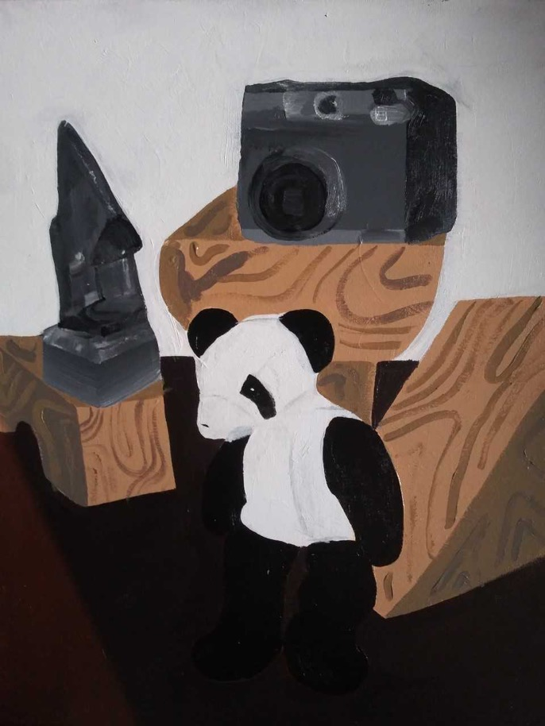
Panda by Celynn Aleman

Slide 65
Panda by Celynn Aleman
I decided to paint objects that were arranged to make a balanced structure. This structure is filled with faux wood blocks that I used as the base. I composed the structure using a polaroid camera, a small stuffed panda, and a wooden statue of a nose. This piece was overall a fun time, and I found that I have a process that I stick to when creating pieces with inanimate objects. I think the piece could have been taken further and rendered more realistically, but in the end I think I like the finished product.
.

Slide 66
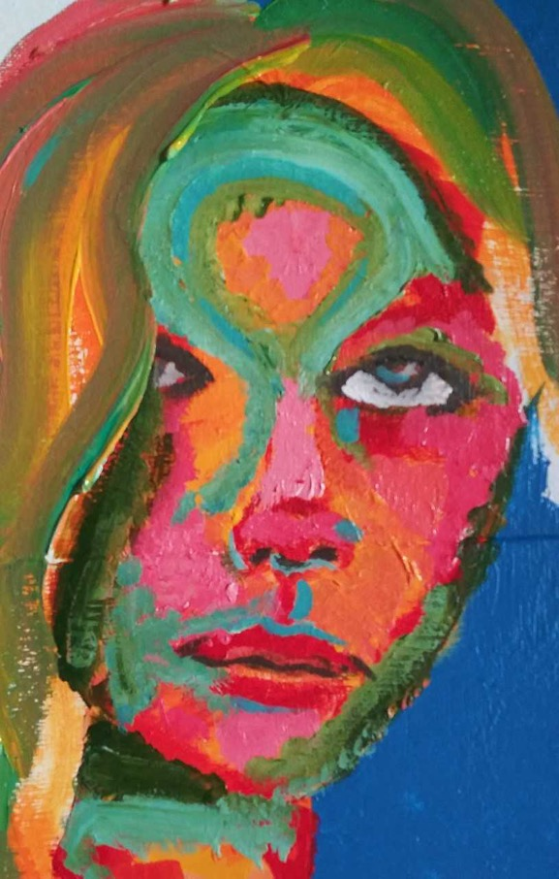
Self-portrait by Celynn Aleman

Slide 67
Self-portrait by Celynn Aleman
I decided to do an abstract self-portrait. The medium is acrylic paint on two canvases combined. I decided to render my portrait in variations of vibrant colors. I found that during the creation of this piece that I had some trouble rendering proportion and mapping out my face. Although, the abstract quality made the process easier. I found that this project gave me an opportunity to develop my ability to create portraits.

Slide 68
Devree Mallory
E

Slide 69
Devree Mallory
Artist Statement
Required personal artist statement not submitted.

Slide 70
Abstract by Devree Mallory

Slide 71
Untitled Abstract by Devree Mallory
Required artist statement about painting not submitted.

Slide 72
In Uncertain Times by Devree Mallory

Slide 73
In Uncertain Times by Devree Mallory
Required artist statement about painting not submitted.

Slide 74
Turn to Me by Devree Mallory

Slide 75
Turn to Me by Devree Mallory
Required artist statement about painting not submitted.

Slide 76
Still Life by Devree Mallory not submitted

Slide 77
Still Life by Devree Mallory
Required artist statement about painting not submitted.

Slide 78
Portrait by Devree Mallory not sumbitted

Slide 79
Portrait by Devree Mallory
Required artist statement about painting not submitted.

Slide 80
Oscar Quintana

Slide 81
Oscar Quintana
Artist Statement
Required personal artist statement not submitted.

Slide 82
The Mutation by Oscar Quintana

Slide 83
The Mutation by Oscar Quintana
This project is influenced by the tone of music, extremely extraordinary music with no vocals. The music I was listening to comes from a video game called Resident Evil 2 which was initially published on January 21, 1998, but the remake was released the previous year on January 25, 2019. The music is so strange it brought me to paint an abstract that is particularly unusual, dark, and creature-like. If you know the video game you will catch sight of how identical the painting is to some of the creatures establish in this video game, of course in a more abstracted manner. I have utilized my beloved patterns and integrated them in a way that would make this piece remarkable. I also included painting gray scales in the background, so it makes this piece more fascinating then leaving the background blank and boring. This piece is bizarre, which stops people in their tracks. This is my intention in this incredible masterpiece.

Slide 84
Sacred Stronghold by Oscar Quintana

Slide 85
Sacred Stronghold by Oscar Quintana
This assigned cityscape painting exemplifies the architecture of churches and how medieval they can look. I did thisoriginal composition because I used to be in advanced architecture studies in school and architecture is what interests me when it comes to the style of the facility. I really enjoy the towers at the crown of this facility because there are numerous contours that give this piece character. This piece has encouraged me to paint as realistic as I possibly can. I also learned my limitations on how realistic I can get. I use an assortment of colors that allow this piece to be as natural as it can be.

Slide 86
The Elephant in the Room by Oscar Quintana

Slide 87
The Elephant in the Room by Oscar Quintana
This still life is a realistic piece depicting an elephant statue resting on a shelf on the wall. I believed the title of this piece would be amusing since most know what it implies. In this piece, I had utilized an assortment of colors that helped strengthen this painting. I find this painting extremely fascinating because of the shapes used throughout this painting. The reddish background wall I find is a more intriguing color than the basic wall that was a real plane color. The red gives it a more warm color impression to the person observing this painting.

Slide 88
Portrait by Oscar Quintana not submitted

Slide 89
Portrait by Oscar Quintana
Required portrait assignment statement not submitted

Slide 90
Joseph Delgado

Slide 91
Joseph Delgado
Artist Statement
The general idea behind my pieces is to capture the quirks, whimsy, and fanciful nature that describes elements within and outwardly. For example, nature if simplified, can be seen as fanciful, quirky, or whimsical. In all actuality nature whether it be in the form of forests or oceans and even in human nature, overall tends to be capricious. That is a philosophical and spiritual tenet that forms the basis of my works. Also, exploring the ideas of Masters who came before through art history; I have come to understand some of the ideas present in my own works. Not to compare or say that I’m just as good but to develop an understanding of the processes that have influenced most people who have viewed art and have no idea what technique was employed and me. in my works. Continued….

Slide 92
Not to compare or say that I’m just as good, but to develop an understanding of the processes that have influenced most people who have viewed art and have no idea what technique was employed and me.
Another influence is daydreaming, as far back as I can remember I have been daydreaming and in healthy circumstances it can be seen as a coping mechanism for stress or anxiety. In my case it has not become maladaptive in that it hasn’t caused a negative impact on my life. It has actually helped me tremendously up to this point. It is a cornerstone of my well-being that I have also explored in my works.

Slide 93
No.1 by Joseph Delgado

Slide 94
No.1 by Joseph Delgado
I decided to name my abstract painting No.1 because this is the first time I’ve painted. There is really no witty or creativity to it but it works. I decided and made the conscious choice to use primary colors as I have on my first painting because I believe we all should start with the basics and work our way up from there.
I was also inspired by infants, children, and innocence; my childhood wasn’t particularly good but I know in my heart of hearts and logically that it could have been worse. There is a ”tear” in just about everything I do, from writing, to drawing, etc. I wanted to in No.1, capture a time before the sadness in me crept in. I try to use my “shadow” in positive ways because we all have them, some darker than others, I think that is one thing that defines me. I love the freedom of abstract art and its ambiguous nature. Since I’m a beginner at this I feel that through time and practice I can get better just like anyone else.

Slide 95
Snow by Joseph Delgado

Slide 96
Snow by Joseph Delgado
In this piece I was really trying to hit one note, seeing that it is predominantly using purple tones with some yellow. Purple being the main mood I wanted to convey and the simplicity of the landscape, I want it to feel easy and peaceful with a little warmth.
I called it snow because sonically when it snows it mutes out sound that’s why it's so quiet after a snow. Silence as I have observed it is a force for reflection and it can’t be underestimated, for me it really lets me realign with myself and recharge.

Slide 97
Bones by Joseph Delgado

Slide 98
Bones by Joseph Delgado
The still life is something that we all as art students begin our journey into the artistic experience with. Just as it is essential and the framework for our education just like the bones of the body which support our figures, that’s the inspiration behind this.
I think that the complexity of the shell juxtaposed with the relative simplicity of the pear and pepper, give it a nice contrast. It again almost exactly uses the primary colors of red, blue and yellow. I wanted to use flesh and earthy tones on the shell to convey life and earth.

Slide 99
Dead Sea by Joseph Delgado

Slide 100
Dead Sea by Joseph Delgado
This is a portrait of Butoh dancer Kazuo Ohno, I wanted this to be like a document or photo that captured a statement. With the indescribable and maybe even horrific expression on his face I wanted to make the viewer feel as though they caught a snapshot of his spirit.
I wanted the piece to look as realistic as possible so I used drawing techniques and a paint marker to literally draw the face onto the canvas. To finish it I wanted to add as many values as possible to give it an almost matte photo-realistic quality.

Slide 101
Anthony Kiser

Slide 102
Anthony Kiser
Artist Statement
Required personal artist statement not submitted.

Slide 103
Sexual Daylight by Anthony Kiser

Slide 104
Sexual Daylight by Anthony Kiser
This abstract is painted digitally and printed on canvas, which is known as a giclee. My synesthesia inspiration on this abstract piece was a beautiful girl i had met down in California the way her voice sounded to me. Colorful and peaceful is how I interpreted her voice.

Slide 105
Outdoors by Anthony Kiser

Slide 106
Outdoors by Anthony Kiser
Outdoors is my digitally painted landscape piece which was inspired by Bob Ross, i always wanted to paint a landscape, and he has always inspired me to do so.

Slide 107
Yoo-Hoo by Anthony Kiser

Slide 108
Yoo-Hoo by Anthony Kiser
Yoo-Hoo‘ is my digitally painted still life painting and when i thought about this project, people always paint fruit or something boring so i wanted to do my favorite drink.

Slide 109
Johnny from Down the Street by Anthony Kiser

Slide 110
Johnny from Down the Street by Anthony Kiser
Johnny from Down the Street was my digitally painted portrait and this was entirely in my comfort zone. I had saw Johnny the day before walking his dog and thought he’d be a great portrait and asked him, using nothing but paint brushes, i believe it turned out well.

Slide 111
End

